Slide 1

ES and IoT
Smart Plant Monitoring System
Instructor: Prof. Arpit Khandelwal
Team Members:
Jyotiraditya Singh Rathore B23ES1017
Shreyansh Agarwal B23PH1024

Slide 2
MOTIVATION
  Water Efficiency & Sustainability: Automate irrigation to reduce water wastage by watering only when soil moisture is low.
  Low-Cost Smart Agriculture: Provide an affordable, IoT-based solution using ESP8266 and basic sensors for small-scale farmers or gardeners.
  Real-Time Remote Monitoring: Enable users to monitor and control plant health from anywhere via MQTT promoting convenience and scalability.
  Power-Efficient IoT Design: Implements event-based data publishing and periodic sensor polling to minimize energy consumption, ideal for low-power IoT environments.

Slide 3
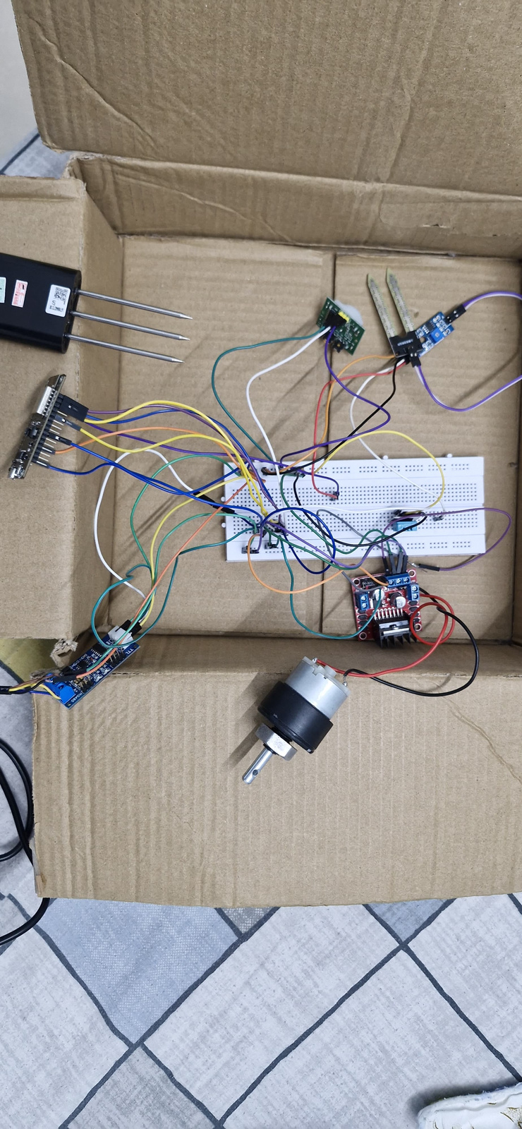
PROJECT OVERVIEW
i.Title: Smart Plant Monitoring System
ii. Objective:To automate plant health monitoring
and using low-cost IoT components and enable remote control
and alerts via MQTT.
iii. Key Features:
  Soil moisture sensing with automatic and manual motor control
  Temperature and humidity monitoring via DHT11
  Nutrient (NPK) measurement using Modbus communication
  Motion detection using PIR sensors
  Real-time data publishing and alerts using MQTT
iv. Target Users:Home gardeners, small-scale farmers,agricultural researchers,
and IoT learners.
v. Technologies Used: Hardware: ESP8266 NodeMCU, DHT11, Moisture sensors, PIR sensors, NPK sensor,
Motors, MQTT protocol, PubSubClient, ModbusMaster library.

Slide 4
WORKFLOW
Initialization:
  ESP8266 connects to Wi-Fi.
  MQTT client connects to the MQTT broker.
  Sensors (moisture, PIR, temperature, humidity, NPK) are read, and initial data is published.
Sensor Data Collection:
  Periodic readings from moisture sensors, PIR sensors, DHT11, and NPK sensor.
  Moisture levels are compared to thresholds to decide if watering is needed.
Motor Control:
  If moisture is below threshold, motor starts watering the plant.
  If moisture is above threshold, motor stops watering.
  Manual motor control via MQTT commands.
Data Publishing:
  Sensor data (moisture, PIR, temperature, humidity, NPK) is published to MQTT topics.
  Only updated values are sent to reduce traffic and power consumption.
  Notifications:
    Notifications (e.g., watering started/stopped, motion detected) are sent to MQTT for monitoring.
  Wi-Fi/MQTT Reconnection:
    Automatically reconnects if Wi-Fi or MQTT connection drops.

Slide 5
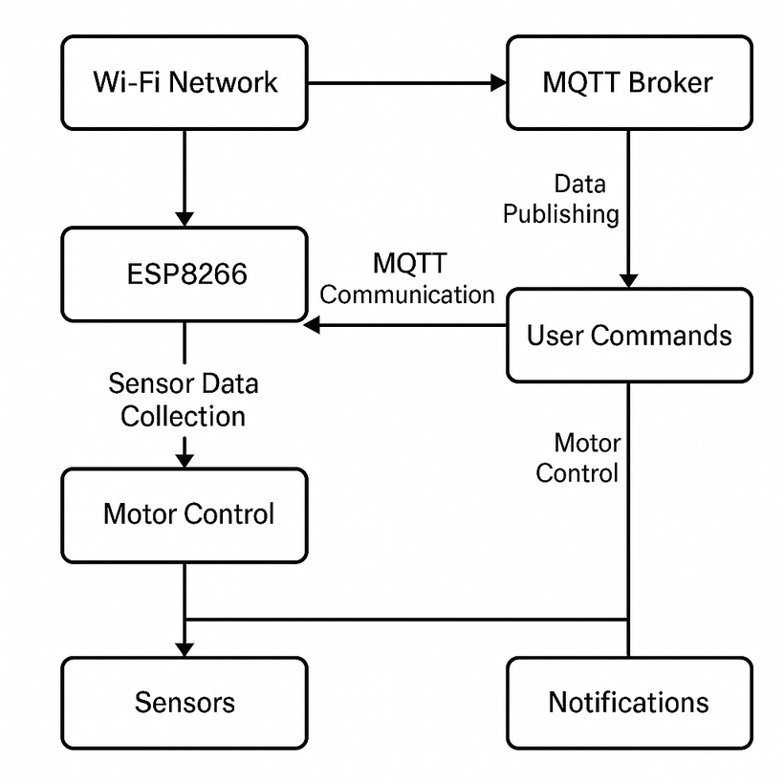
ARCHITECTURE
ESP8266:
  Controls sensors and motors.
  Manages Wi-Fi and MQTT communication.
Wi-Fi Network:
  ESP8266 connects to a local Wi-Fi network to access the MQTT broker.
MQTT Broker:
  Acts as a central point for communication, receiving sensor data and sending
motor control commands.
Sensors:
  Moisture Sensors: For soil moisture measurement.
  PIR Sensors: For motion detection.
  Temperature and Humidity (DHT11): For environmental monitoring.
  NPK Sensor: For soil nutrition (using Modbus communication).
Motor Control:
  Motors are activated/deactivated based on soil moisture readings and user input
(via MQTT).

Slide 6
Results and Learning
  Successfully built a smart system that monitors soil moisture, temperature, humidity, NPK levels, and motion, triggering irrigation automatically when needed.
  Gained hands-on experience with ESP8266, sensor integration, and real-time data communication using MQTT.
  Understood the fundamentals of IoT-based automation, including sensor calibration, wireless communication, and embedded system design.

Slide 7
AI-Based Plant Health Diagnosis:
  Integration of image processing and machine learning to detect plant diseases, nutrient deficiencies, or pest infestations using camera input.
FUTURE SCOPE
Automated Nutrient and Water Dosing:
  Use of NPK and moisture sensor data to automatically control nutrient injectors and irrigation systems for optimal plant growth (precision agriculture).
Cloud Connectivity and Mobile App Integration:
  Real-time monitoring and control via a mobile app or web dashboard, with features like historical trends, plant care reminders, and push notifications for anomalies.

Slide 8
Thank you

